Slide 1
Descriptive Analytics
Market Segmentation

Slide 2

Byron Sharp (2017) Marketing : Theory, Evidence, Practice
Chapter 6. Customer Segmentation and Targeting

Slide 3
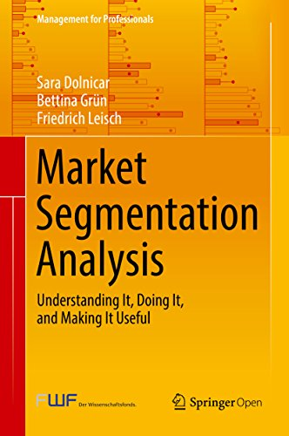
‘Another book on market segmentation’ you think. Many outstanding marketing scientists, scholars and consultants have written excellent books on market segmentation.
...
Our excuse for writing yet another book on market segmentation is to bridge the gap between the managerial and the statistical aspects of market segmentation analysis.
https://link.springer.com/book/10.1007%2F978-981-10-8818-6
http://www.marketsegmentationanalysis.org/

Slide 4
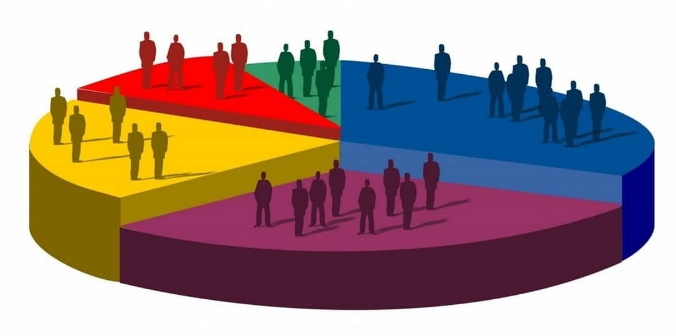
Market segmentation
Segmentation
Males and females of different shapes and sizes, children – clothing, shoes
Climate or cultural differences
Targeting or Positioning
Target some distinctive segment
Position your company as belonging or appealing to some segment
Examples
Peroni Beer – Italian beer
Italian pizza

Slide 5


Market segmentation

Slide 6
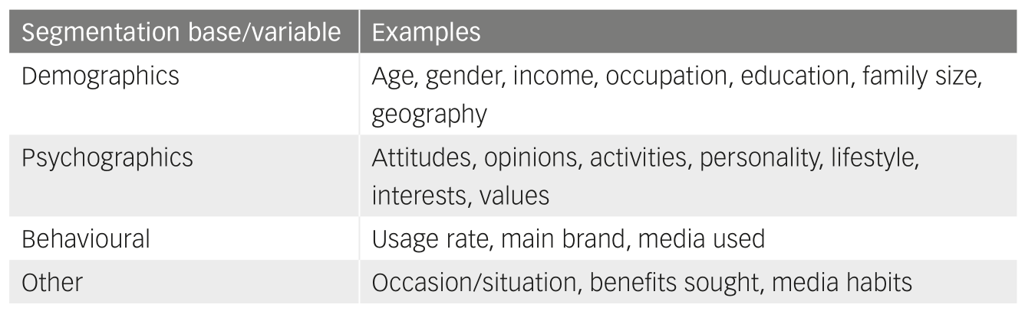
How might researcher choose to segment?
Measurable, Durable, Accessible, Different, Substantial

Slide 7
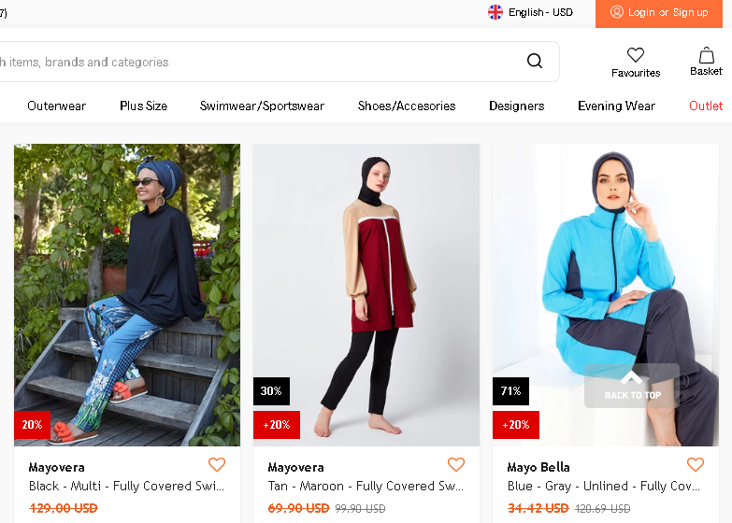
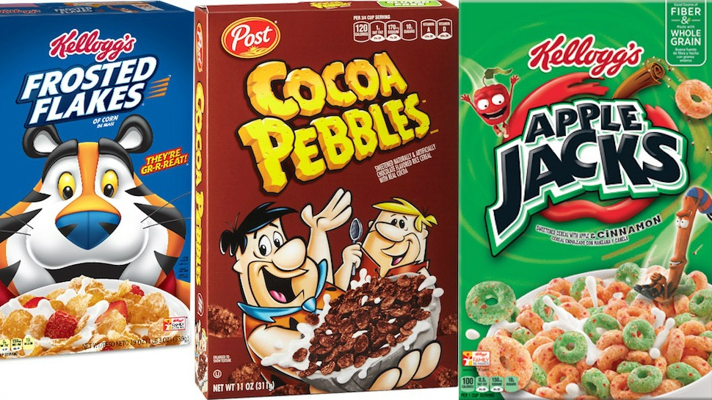
Customers VS Consumers
Cereals for Kids
Burkini

Slide 8
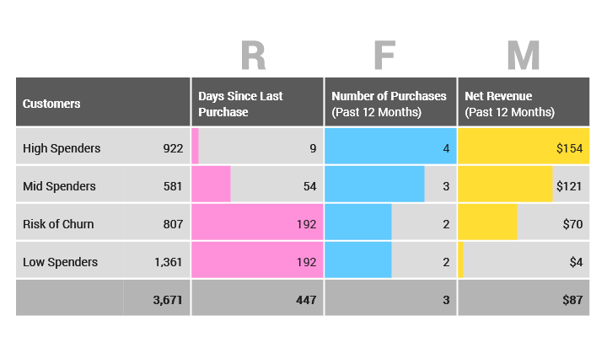
Database-driven targeting
Recency, Frequency, and Monetary value (RFM)
Existing customers base VS new customers
Heavy VS Light customers

Slide 9
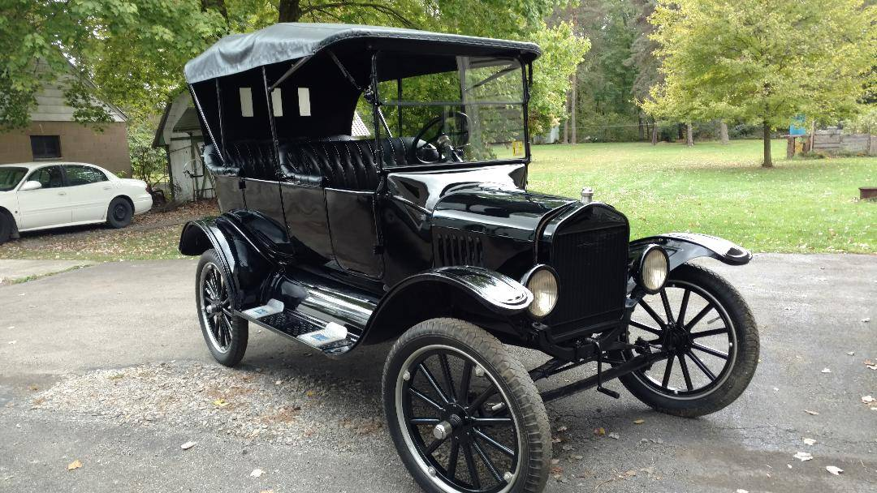
Methods for segmentation
Business rules
Arbitrary criteria from demographics, psychographics and/or behavior
Arbitrary quantile /threshold membership from above characteristics
Clustering
Unsupervised methods of data analysis
Henry Ford: ‘Any customer can have a car painted any colour that he wants so long as it is black’.

Slide 10
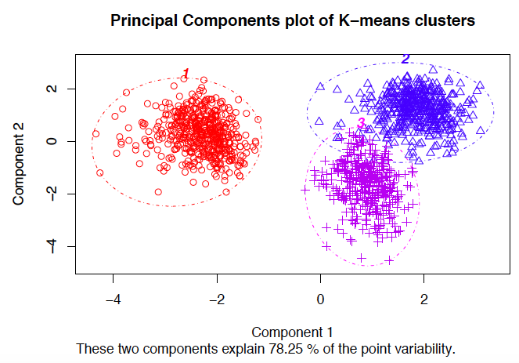
Review Clustering
Unsupervised classification
Choose meaningful variables
Select a measure of a distance or similarity/dissimilarity
Maximize between group distance and minimize within group distance
Interpret resulted clusters

Slide 11
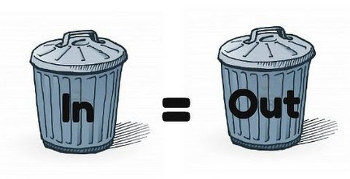
Selection of variables
Remember GIGO
Your variables:
are meaningful for the analysis objective
are (relatively) independent
are limited in number
are numerical (one hot encoding for categorical)
have low kurtosis and skewness statistics (at least in the training set)

Slide 12
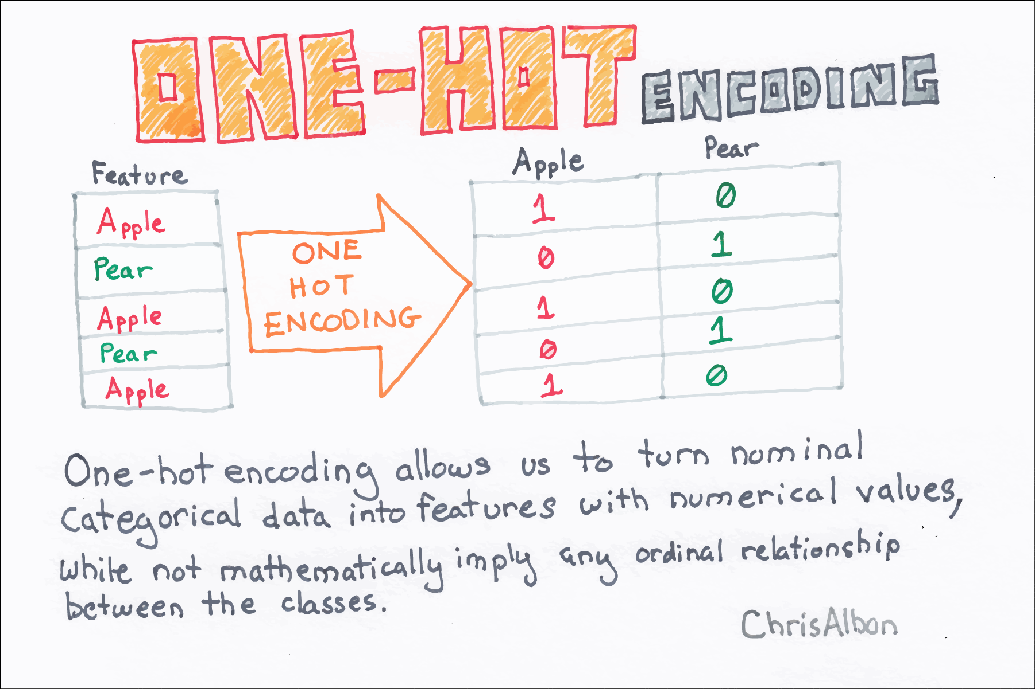
One-hot encoding
> customers <- data.frame(id=c(1, 2, 3, 4), gender=c('M', 'M', 'M', 'F'),
mood=c('happy’, 'sad', 'happy’, 'sad'))
> customers
id gender mood
1 1 M happy
2 2 M sad
3 3 M happy
4 4 F sad
> library(data.table)
> library(mltools)
> customers <- one_hot(as.data.table(customers))
> customers
id gender_F gender_M mood_happy mood_sad
1: 1 0 1 1 0
2: 2 0 1 0 1
3: 3 0 1 1 0
4: 4 1 0 0 1
https://chrisalbon.com/

Slide 13
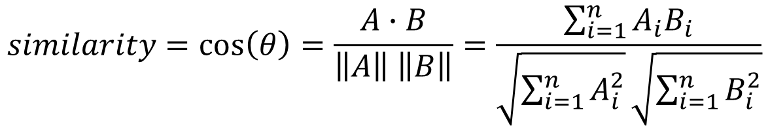
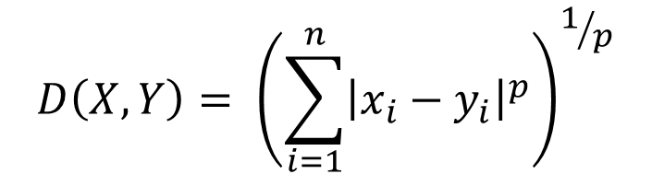
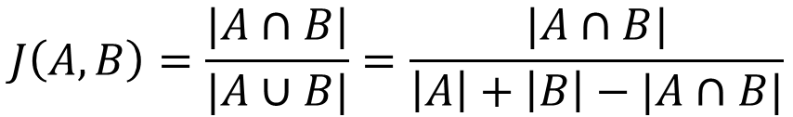
Measure of distance
$$D\left(X,Y\right)= {\left(\sum_{i=1}^{n}{{\left|x_{i}−y_{i}\right|}^{p}}\right)}^{1/p}$$
Manhattan, Euclidian, Minkowski distance:
Cosine distance:
Jaccard distance:
$$similarity=\cos\left(θ\right)=\frac{A∙B}{\left\|A\right\| \left\|B\right\|}=\frac{\sum_{i=1}^{n}{A_{i}B_{i}}}{\sqrt{\sum_{i=1}^{n}{A_{i}^{2}}}\sqrt{\sum_{i=1}^{n}{B_{i}^{2}}}}$$
$$J\left(A,B\right)=\frac{|A∩B|}{|A∪B|}=\frac{|A∩B|}{\left|A\right|+\left|B\right|−|A∩B|}$$
https://en.wikipedia.org/wiki/Category:Similarity_and_distance_measures

Slide 14
Clustering types and algorithms
Hierarchical clustering (AGNES, DIANA)
Partition-based clustering (k-Means, k-Medoids)
Mean-shift clustering
Density-Based Spatial Clustering of Applications with Noise (DBSCAN)
Expectation–Maximization (EM) Clustering

Slide 15
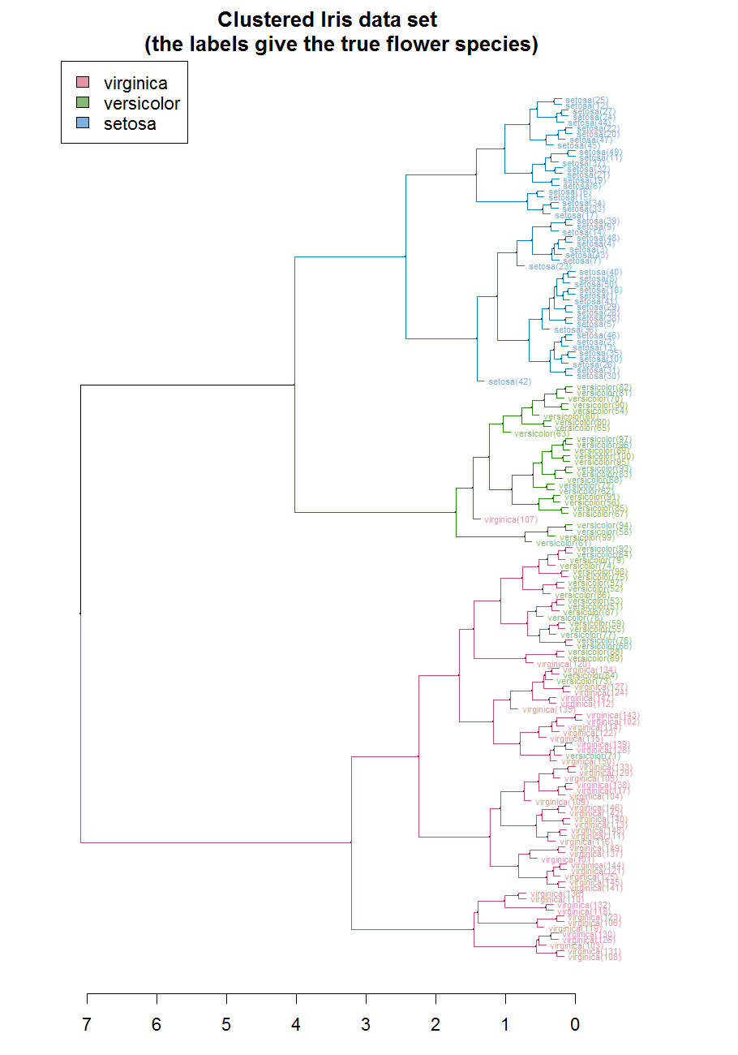
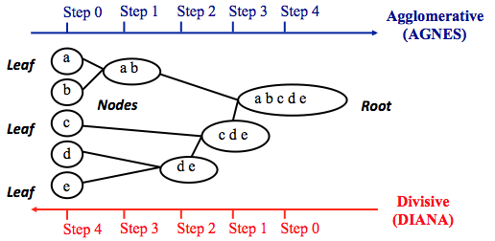
Hierarchical clustering

Slide 16
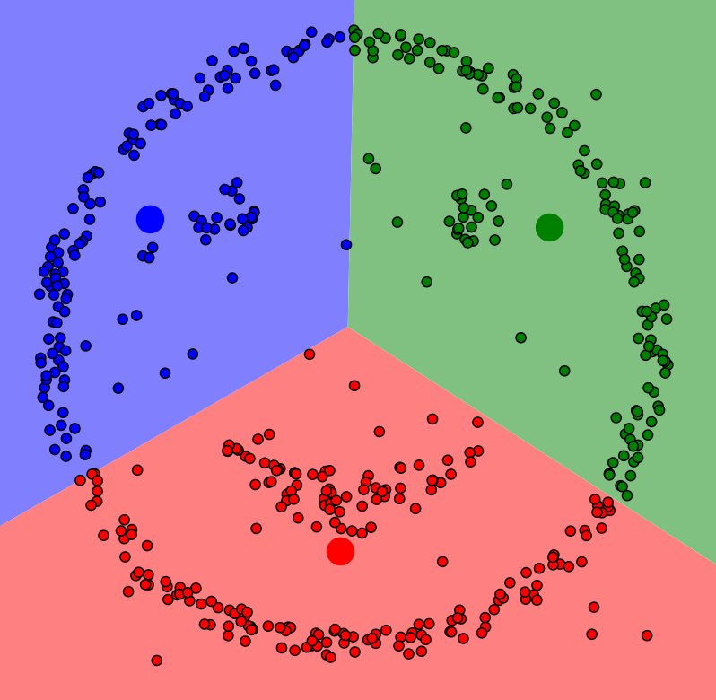
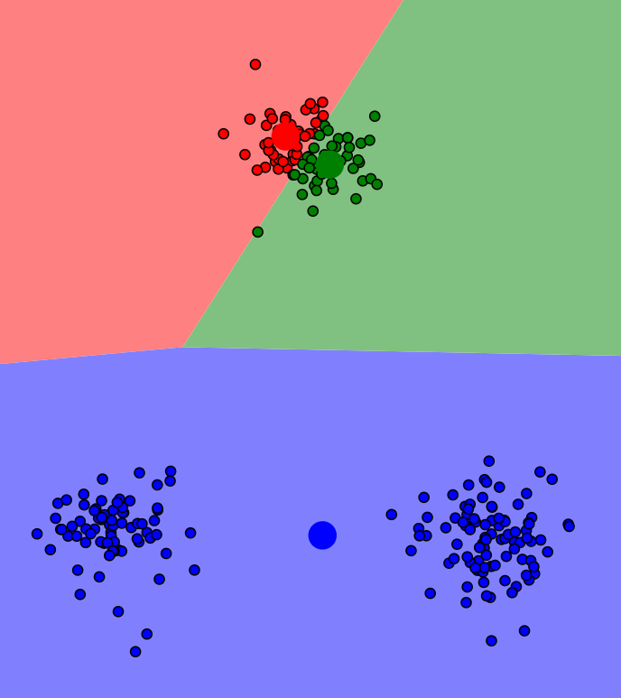
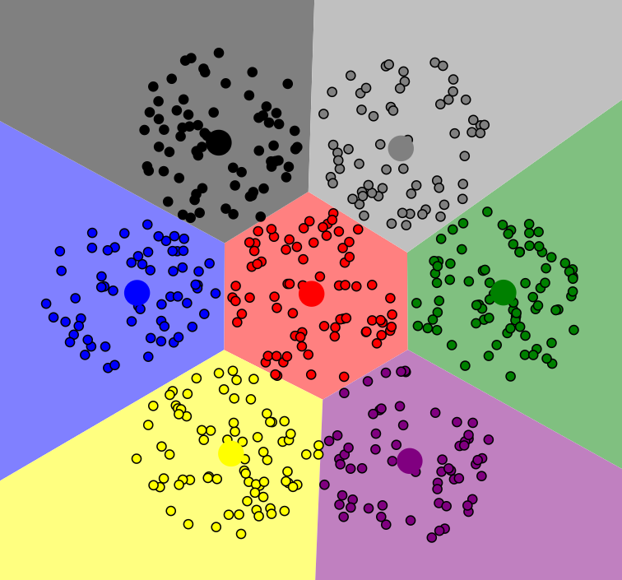
K-Means
https://www.naftaliharris.com/blog/visualizing-k-means-clustering/

Slide 17
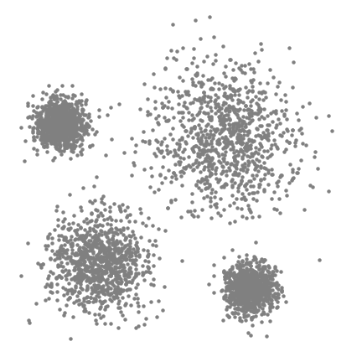
Mean-shift clustering

Slide 18
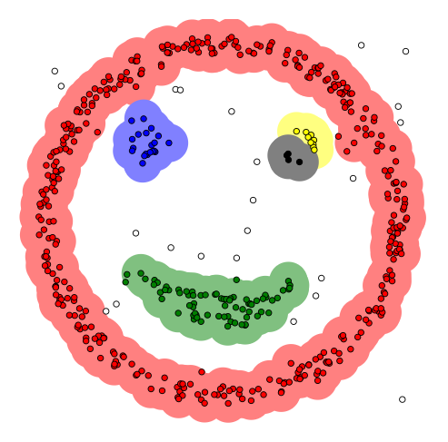
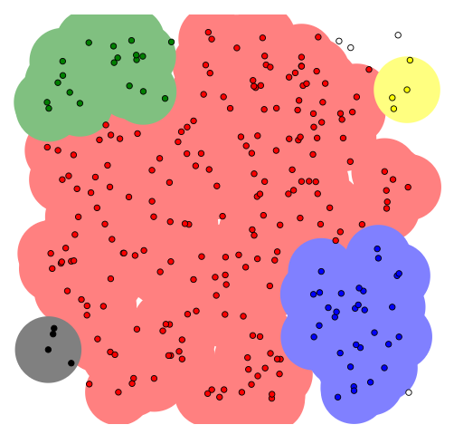
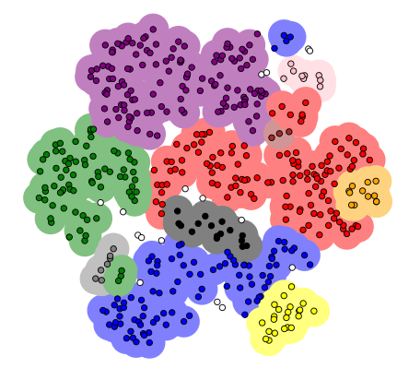
DBSCAN
https://www.naftaliharris.com/blog/visualizing-dbscan-clustering/

Slide 19
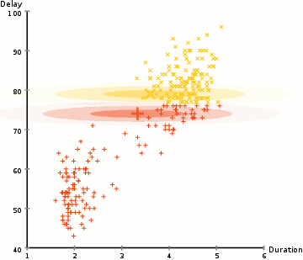
Expectation–Maximization (EM) Clustering
Expectation–Maximization (EM) Clustering using Gaussian Mixture Models (GMM) of Old Faithful eruption data

Slide 20
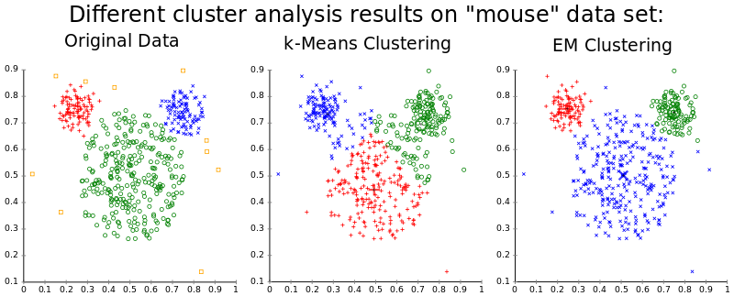
Expectation–Maximization (EM) Clustering

Slide 21
Example: Tourist Risk Taking
The data set contains 563 respondents who state how often they take risks from the following six categories:
recreational risks: e.g., rock-climbing, scuba diving
health risks: e.g., smoking, poor diet, high alcohol consumption
career risks: e.g., quitting a job without another to go to
financial risks: e.g., gambling, risky investments
safety risks: e.g., speeding
social risks: e.g., standing for election, publicly challenging a rule or decision
Respondents are presented with an ordinal scale consisting of five answer options [NEVER(1), RARELY(2), QUITE OFTEN(3), OFTEN(4), VERY OFTEN(5)].

Slide 22
Tourist Risk Taking
> risk <- read_csv("risk.csv")
> dim(risk)
[1] 563 6
> head(risk)
# A tibble: 6 x 6
Recreational Health Career Financial Safety Social
<int> <int> <int> <int> <int> <int>
1 3 2 1 2 2 4
2 1 1 1 1 1 1
3 2 2 1 1 2 3
4 1 1 1 1 1 1
5 5 4 1 3 5 5
6 5 2 5 3 2 3
> colMeans(risk)
Recreational Health Career Financial Safety Social
2.190053 2.396092 2.007105 2.026643 2.266430 2.017762

Slide 23
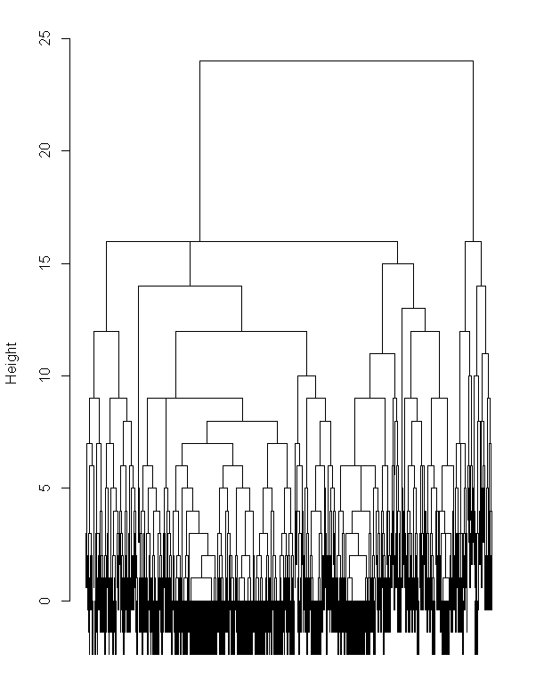
Tourist Risk Taking
> risk.dist <- dist(risk, method = "manhattan")
> risk.hcl <- hclust(risk.dist, method = "complete")
> risk.hcl
Call:
hclust(d = risk.dist, method = "complete")
Cluster method : complete
Distance : manhattan
Number of objects: 563
> plot(risk.hcl, main = "", labels = FALSE)

Slide 24
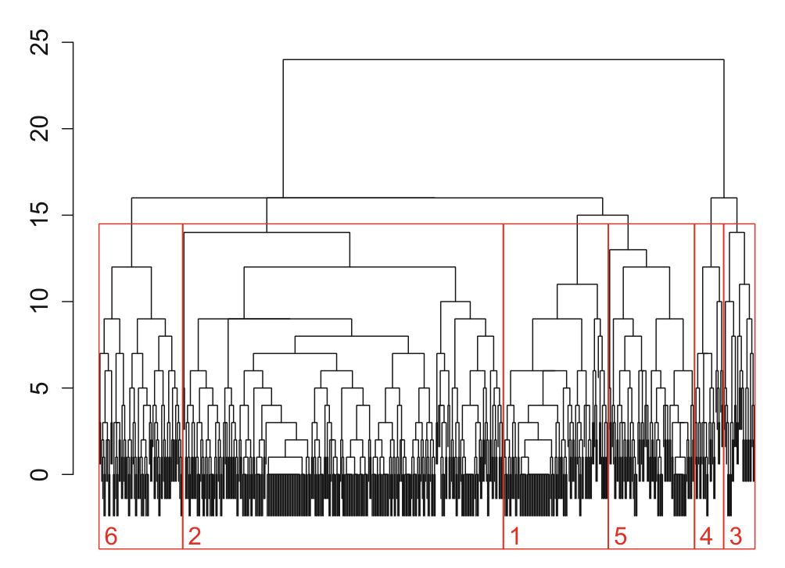
Tourist Risk Taking
> c2 <- cutree(risk.hcl, h = 20)
> table(c2)
c2
1 2
511 52
> c6 <- cutree(risk.hcl, k = 6)
> table(c6)
c6
1 2 3 4 5 6
90 275 27 25 74 72

Slide 25
Tourist Risk Taking
> c2 <- cutree(risk.hcl, h = 20)
> table(c2)
c2
1 2
511 52
> c2.means <- aggregate(risk, list(Cluster = c2), mean)
> round(c2.means[, -1], 1)
Recreational Health Career Financial Safety Social
1 2 2.2 1.9 1.9 2.2 1.9
2 4 3.9 3.4 3.0 3.3 3.6

Slide 26
Tourist Risk Taking
> c2 <- cutree(risk.hcl, h = 20)
> table(c2)
c2
1 2
511 52
> c6 <- cutree(risk.hcl, k = 6)
> table(c6)
c6
1 2 3 4 5 6
90 275 27 25 74 72
> c2.means <- aggregate(risk, list(Cluster = c2), mean)
> round(c2.means[, -1], 1)
Recreational Health Career Financial Safety Social
1 2 2.2 1.9 1.9 2.2 1.9
2 4 3.9 3.4 3.0 3.3 3.6
> c6.means <- aggregate(risk, list(Cluster = c6), mean)
> round(c6.means[, -1], 1)
Recreational Health Career Financial Safety Social
1 2.0 2.2 1.9 2.0 2.2 2.8
2 1.9 1.8 1.5 1.6 2.0 1.4
3 3.9 4.4 2.9 3.2 3.3 4.1
4 4.1 3.3 4.1 2.8 3.4 3.2
5 2.3 2.6 3.2 2.6 2.6 2.2
6 2.0 3.8 1.8 2.4 2.3 2.0

Slide 27
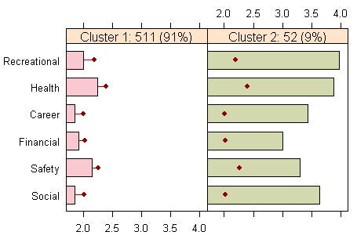
Tourist Risk Taking
> library("flexclust")
>
> barchart(risk.hcl, risk, k = 2)

Slide 28
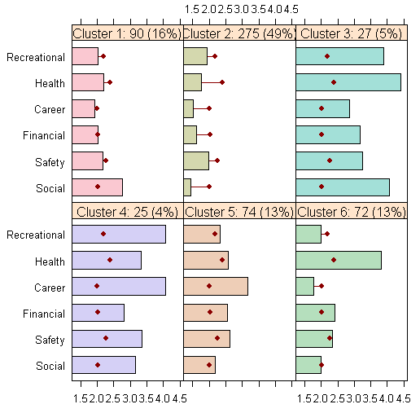
Tourist Risk Taking
> library("flexclust")
>
> barchart(risk.hcl, risk, k = 2)
> barchart(risk.hcl, risk, k = 6)

Slide 29
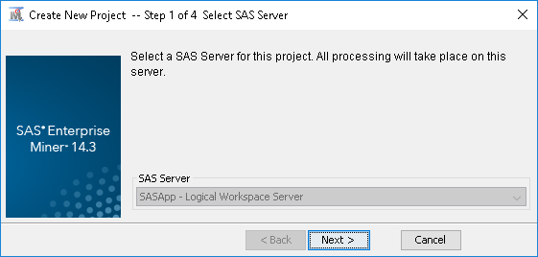
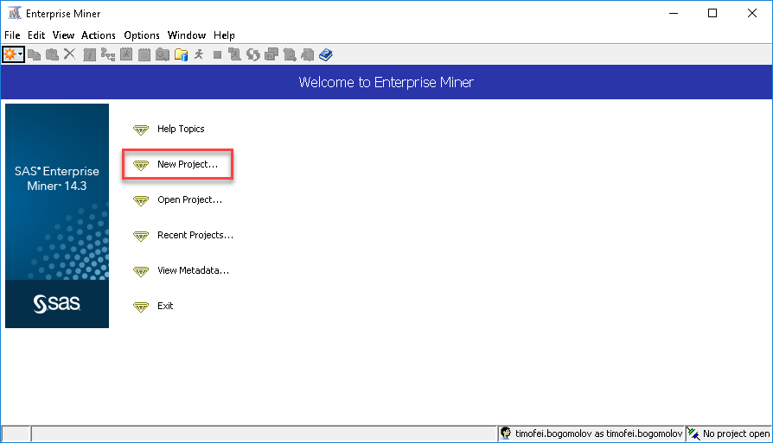
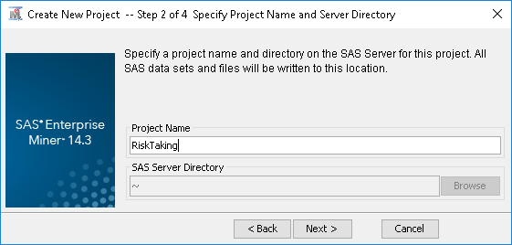
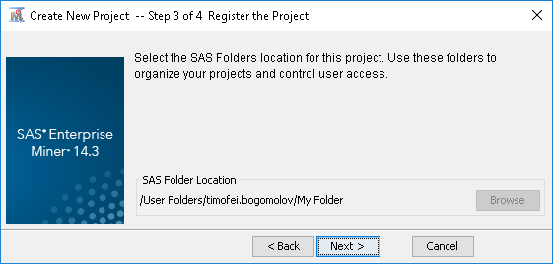
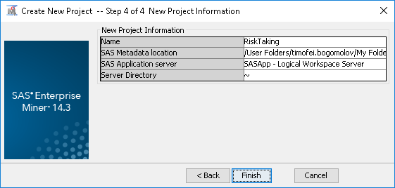
Tourist Risk Taking

Slide 30
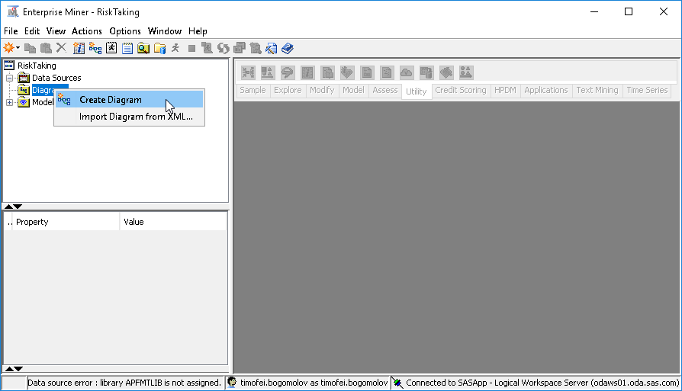
Tourist Risk Taking

Slide 31
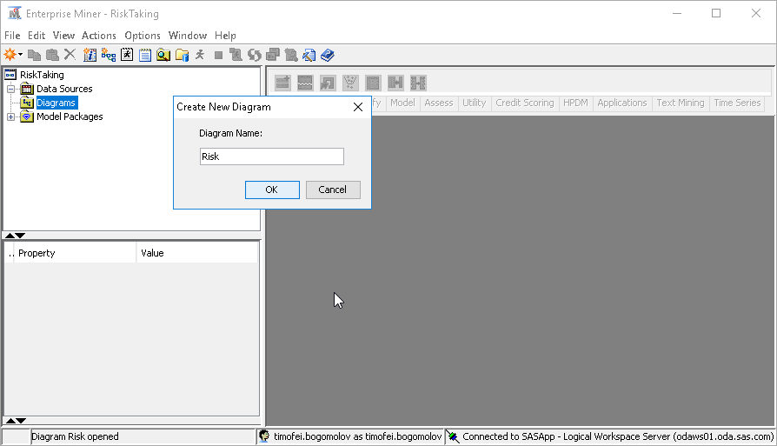
Tourist Risk Taking

Slide 32
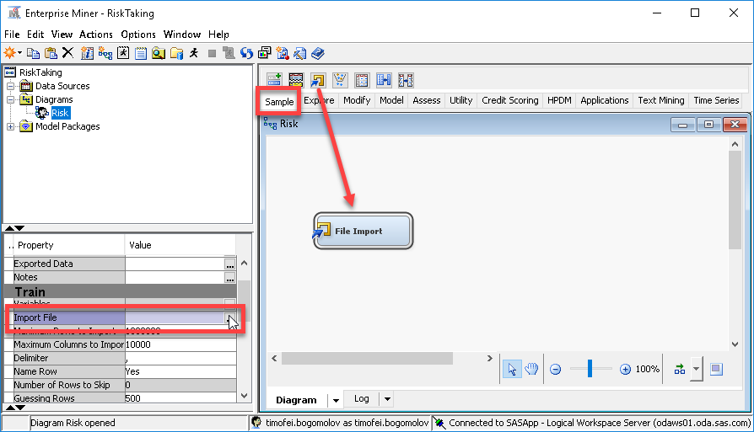
Tourist Risk Taking

Slide 33
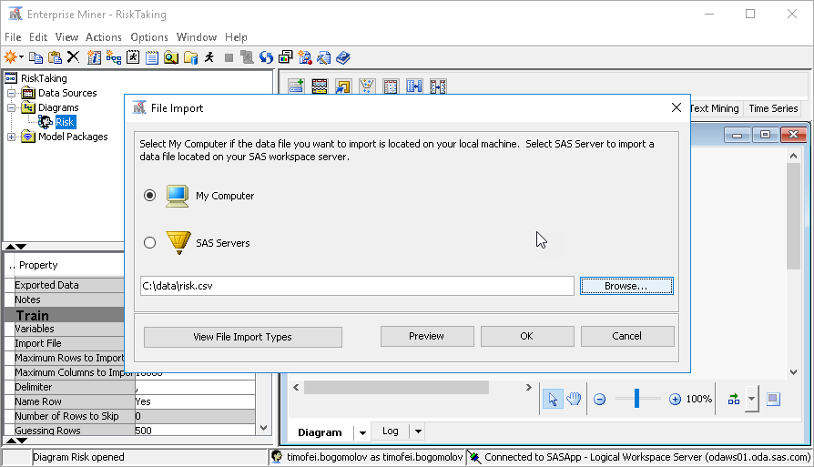
Tourist Risk Taking

Slide 34
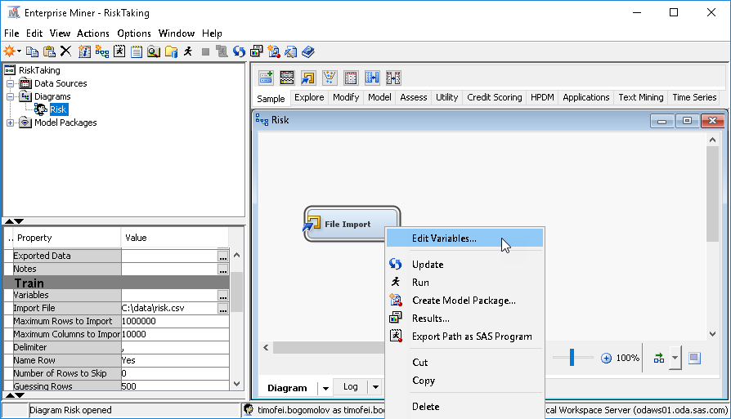
Tourist Risk Taking

Slide 35
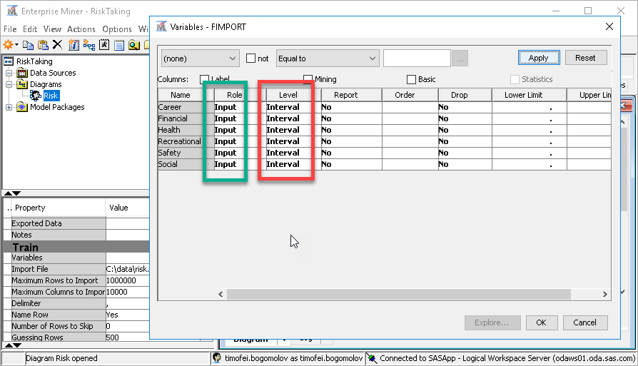
Tourist Risk Taking

Slide 36
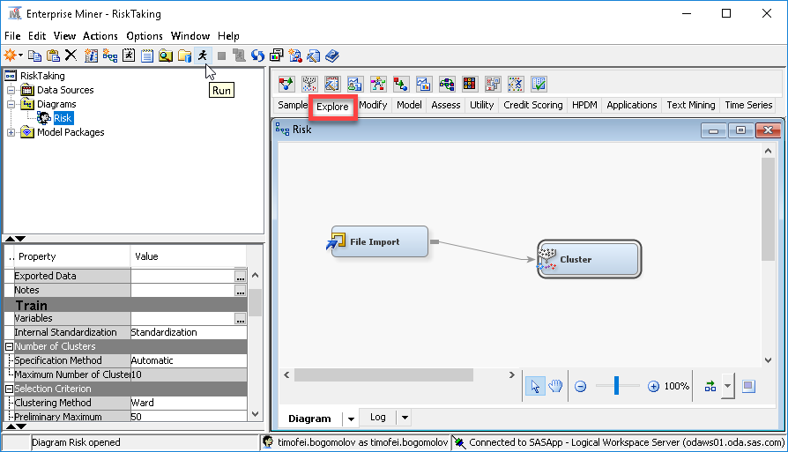
Tourist Risk Taking

Slide 37
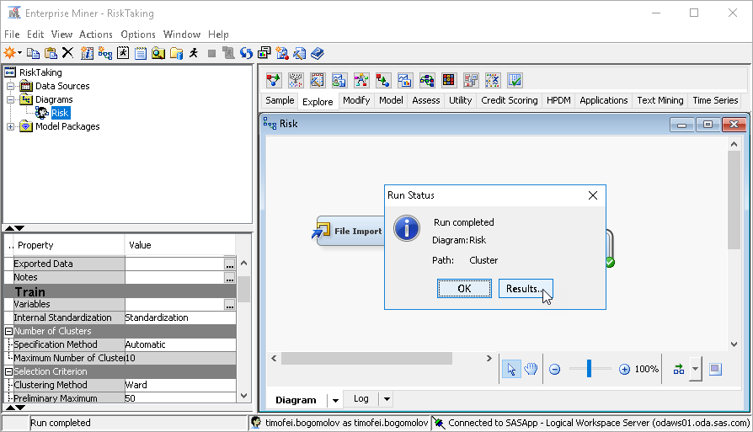
Tourist Risk Taking

Slide 38
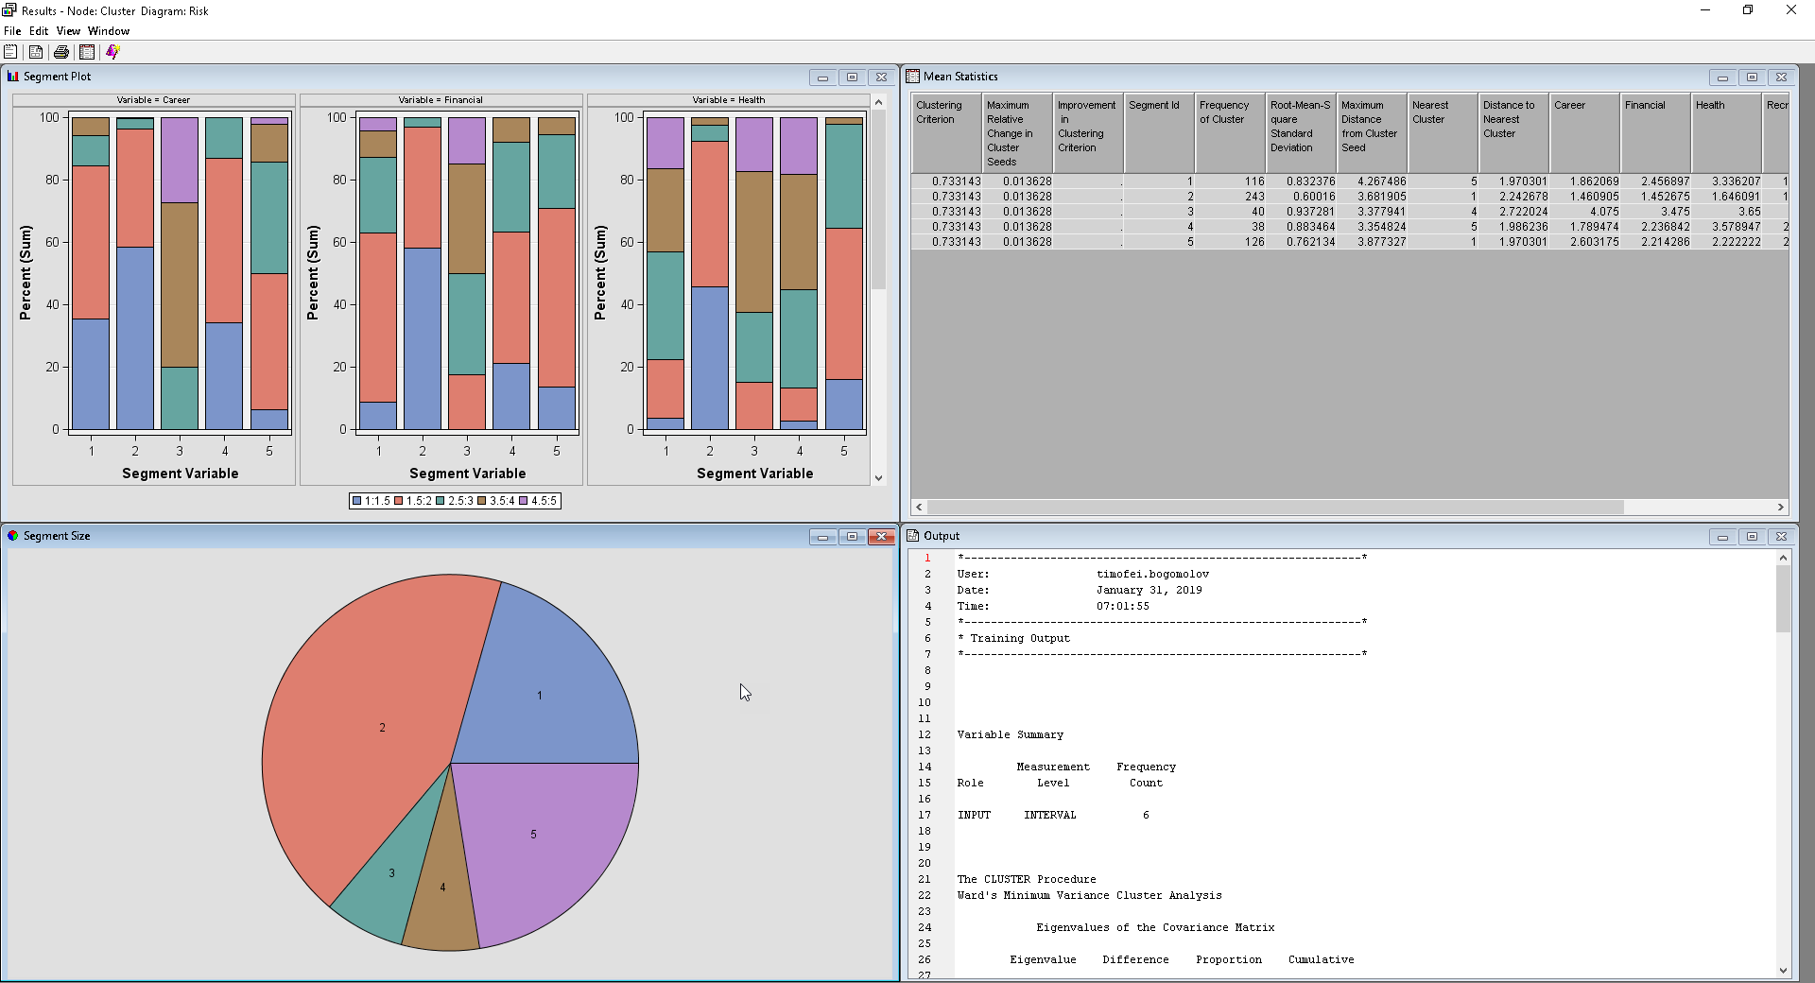
Tourist Risk Taking

Slide 39
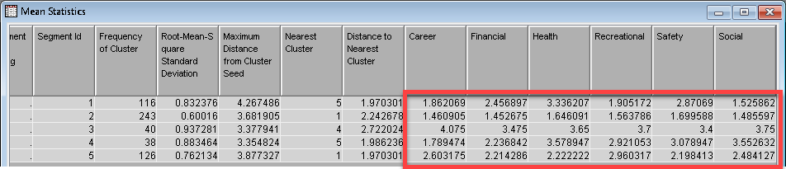
Tourist Risk Taking

Slide 40
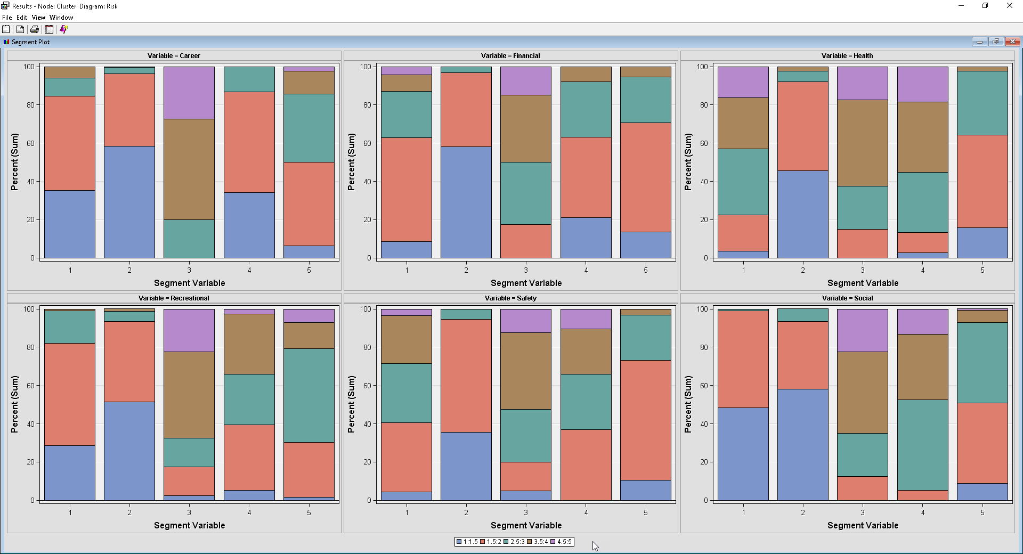

Slide 41
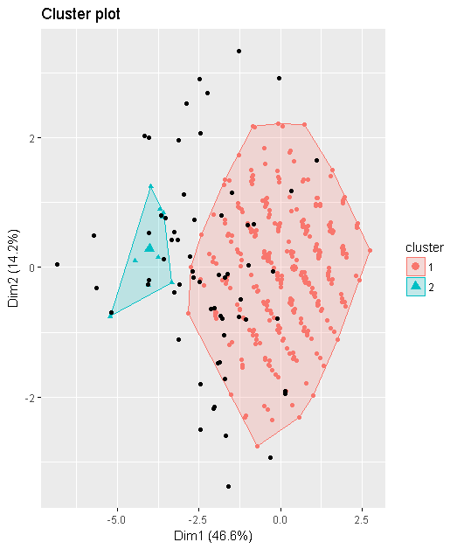
Tourist Risk Taking
> library(dbscan)
> library(readr)
> library("factoextra")
> risk <- read_csv("risk.csv")
>
> res.db <- dbscan(risk, eps= 1.5, minPts = 5)
> res.db
DBSCAN clustering for 563 objects.
Parameters: eps = 1.5, minPts = 5
The clustering contains 2 cluster(s) and 66 noise points.
0 1 2
66 487 10
Available fields: cluster, eps, minPts
> fviz_cluster(res.db, risk, geom = "point")

Slide 42
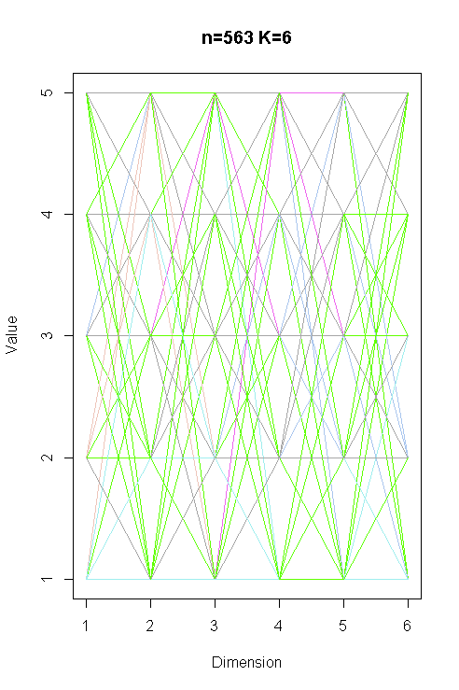
Tourist Risk Taking
> library(EMCluster)
>
> emobj <- simple.init(risk, nclass = 6)
> risk.em <- emcluster(risk, emobj, assign.class = TRUE)
>
> par(mfrow = c(1, 1))
> plotem(risk.em, risk)
>
> summary(risk.em)
Method:
n = 563, p = 6, nclass = 6, flag = , total parameters = 167,
logL = -1276.6759, AIC = 2887.3519, BIC = 3611.0096.
nc:
[1] 35 7 25 200 209 87
pi:
[1] 0.09571 0.04496 0.12445 0.53535 0.15381 0.04572

Slide 43
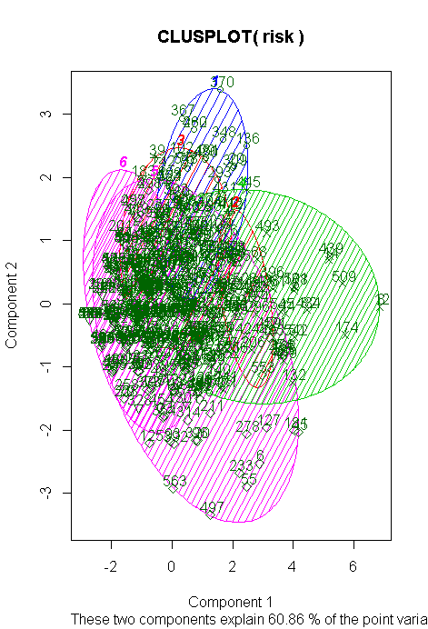
Tourist Risk Taking
> library(cluster)
> clusplot(risk, risk.em$class, color=TRUE,
+ shade=TRUE, labels=2, lines=0)
>
> em.means <- aggregate(risk,
+ list(Cluster = risk.em$class),
+ mean)
> round(em.means[, -1], 1)
Recreational Health Career Financial Safety Social
1 1.8 3.9 2.0 2.7 3.4 1.3
2 1.9 2.3 3.3 3.6 3.7 3.6
3 2.2 3.8 1.4 1.6 2.0 1.4
4 2.6 2.8 2.3 2.5 2.6 2.6
5 2.4 1.9 2.0 1.9 2.1 1.9
6 1.0 1.5 1.4 1.0 1.4 1.4

Slide 44
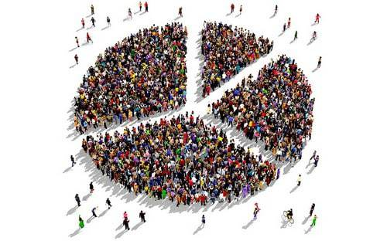
Summary
Segmentation – to do or not to do?
Methods for segmentation: business rules vs clustering
Variables to consider
Distance measures
One-hot encoding
Clustering algorithms
Interpretation of clusters

Slide 45
References
Sharp, B., 2013. Marketing: theory, evidence, practice. Oxford University Press.
Dolnicar, S., Grün, B., Leisch, F., 2018. Market Segmentation Analysis. Understanding It, Doing It, and Making It Useful. Springer Open.

Slide 46
Thank you

